Slide 1



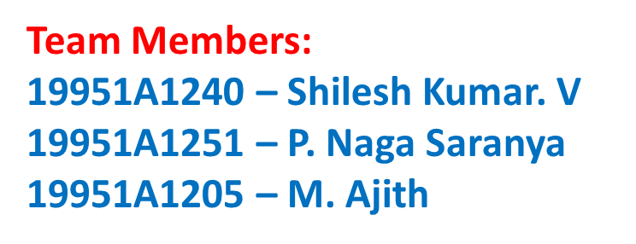

Slide 2

Outline
Abstract
Keywords
Introduction to the topic
Existing System
Drawbacks in existing system
Proposed Work
Advantages
System Architecture
Requirements Analysis
Functional Requirements
Hardware Requirements
Software Requirements

Slide 3
Abstract
According to the World Health Organization (W.H.O), breast cancer is the second most common cancer type among women after lung cancer. Breast cancer occurs when some breast cells begin to raise abnormally. It can arise in any portion of the breast and it can be prevented if the treatment is started at the early stage. Breast cancer is a collection of cancer cells arising from the cells of the breast which can be also call as malignant tumour. Breast cancer’s treatment depends on the type and the stage of cancer the patient is suffering from (zero to fourth). This treatment may include surgery, radiation, or chemotherapy.

Slide 4
Abstract
This paper focuses on the diagnosis of breast cancer using various classification algorithms. Over the last few decades, classifiers with high disease classification performance have been developed and are in high demand. A good classifier is outfitted with highly accurate classification rules derived from historical diagnosis. Because each diagnosis consists of a large number of data features, it is difficult to build minimally accurate high-accuracy classification rules from such historical data and the classification rules are derived from previous diagnoses with a large number of features.

Slide 5
Abstract
It is difficult to build a small number of rules that perform well while retaining all diagnosis information. As a result, the goal of this paper is to find the best performance classifier with the fewest classification rules. According to the results of the experiment on the Breast Cancer data set, the J48 decision tree classifier is the best of the three classifiers: J48 decision tree, Reduced Error Pruning Tree, and Random Tree.

Slide 6
Key words
Breast cancer
Machine Learning
Classification
Classifier
Accuracy
Decision Tree

Slide 7
Introduction to the topic
Breast cancer is one of the most burning problems worldwide today. It is one of the major health problems facing women. Globally, the incidence of breast cancer ranks second after that of lung cancer. The disease is the leading cause of cancer death in women. Breast cancer develops from breast tissue. The signs of breast cancer can contain a large part of the breasts, fluid from the nipple, the chest-shaped change, a new inverted nipple or a flaky patch of the skin. Both genetic and ancestral factor play a role.

Slide 8
Introduction to the topic
About 5-10% of breast cancer are hereditary and occur in the patient with mutation BRCA1, BRCA2 genes.
Risk factors for breast cancer are obesity, alcohol consumption, and a late first pregnancy. Breast cancer usually presents as a palpable mass with discharge from the nipple. Breast cancer can metastasize to bones (70%), lungs (60%), liver (55%), and other organs.

Slide 9
Existing System
Most hospitals today use decision support systems, but they are very limited in terms of getting disease outcomes. You can answer simple questions like “group the age of patients according to each disease”, “diabetes prediction”. Solutions are always taken in a hospital. on the intuition and experience of doctors, and not on the rich knowledge data hidden in the database. Using machine learning, the automatic conclusions of diagnostic rules can be determined from past descriptions, a patient as well as experts and experts can be successfully treated specialists. it will help make the diagnostic process more objective and reliable.

Slide 10
Drawbacks in existing system
No analysis of the previous data.
Uses only Simple statistical solutions.

Slide 11
Proposed work
Classification is a subset of categorization, which is the process of recognizing, distinguishing, and comprehending ideas and objects. For classification, a rule-based classifier employs a collection of IF-THEN rules. From the IF condition THEN conclusion, we may express a rule as follows. A rule-based method for breast cancer diagnosis has proven to be an effective tool in assisting doctors with their diagnoses. Classification rules derived from historical diagnoses are required for such a system.

Slide 12
Proposed work
The desired rules should have a small number of them and operate well. The goal of this study is to find such rules using the Breast Cancer data set. It ran tests on the data set to see which of the J48 decision tree and Random Tree was the best classifier.

Slide 13
Advantages in Proposed Work
We can predict the results using rule-based classifier.
Dynamic nature in prediction.

Slide 14
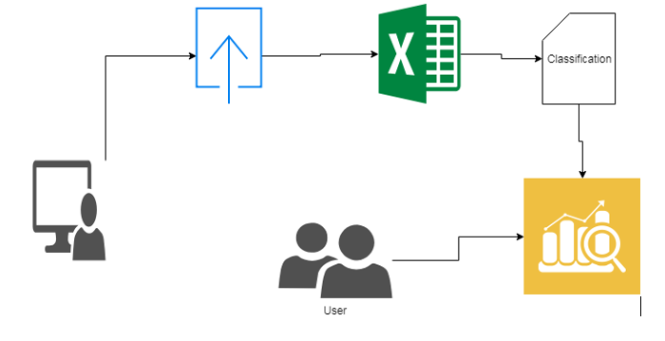
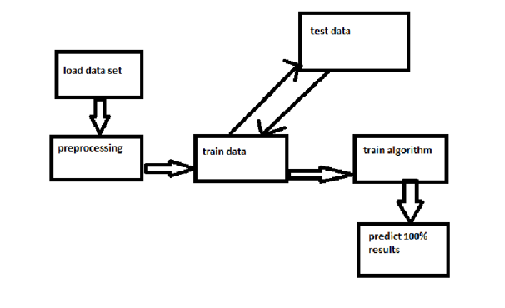
System Architecture

Slide 15
Requirements Analysis
The project involved analyzing the design of few applications so as to make the application more users friendly. To do so, it was really important to keep the navigations from one screen to the other well ordered and at the same time reducing the amount of typing the user needs to do. In order to make the application more accessible, the browser version had to be chosen so that it is compatible with most of the Browsers.

Slide 16
Functional Requirements
Graphical User Interface with the user with these features:-
Admin (Login with administrator details).
Dataset upload (Data set to be uploaded in a given manner).
View dataset (For showing the uploaded data-set).
Classification
Evaluations
User
Prediction

Slide 17
Hardware Requirements
For developing the application the following are the Hardware Requirements:-
Processer : Any Updated Processer
Ram : Min 1 GB
Hard Disk : Min 100 GB

Slide 18
Software Requirements
For developing the application the following are the Software Requirements:-
Operating System : Windows family
Technology : Python 3.6
IDE : PyCharm
UML : Star UML
GUI : tkinter
Debugger/Emulator : Any browser(preferably Chrome)

Slide 19



